Slide 1
Opening a new Burmese Restaurant in Toronto

Slide 2
Creating a hypothetical scenario for a concept Burmese restaurateur who wants to explore opening an authentic Burmese restaurant in Toronto area.

Slide 3
Data
Scrapping of Toronto neighborhoods via Wikipedia
Getting Latitude and Longitude data of these neighborhoods via Geocoder package
Using Foursquare API to get venue data related to these neighborhoods

Slide 4
32
1714 Venues
230 Unique venue categories
Neighbourhoods

Slide 5
And 8 Burmese restaurant But 15 Thai restaurants
Thai and Burmese food are very similar in taste

Slide 6
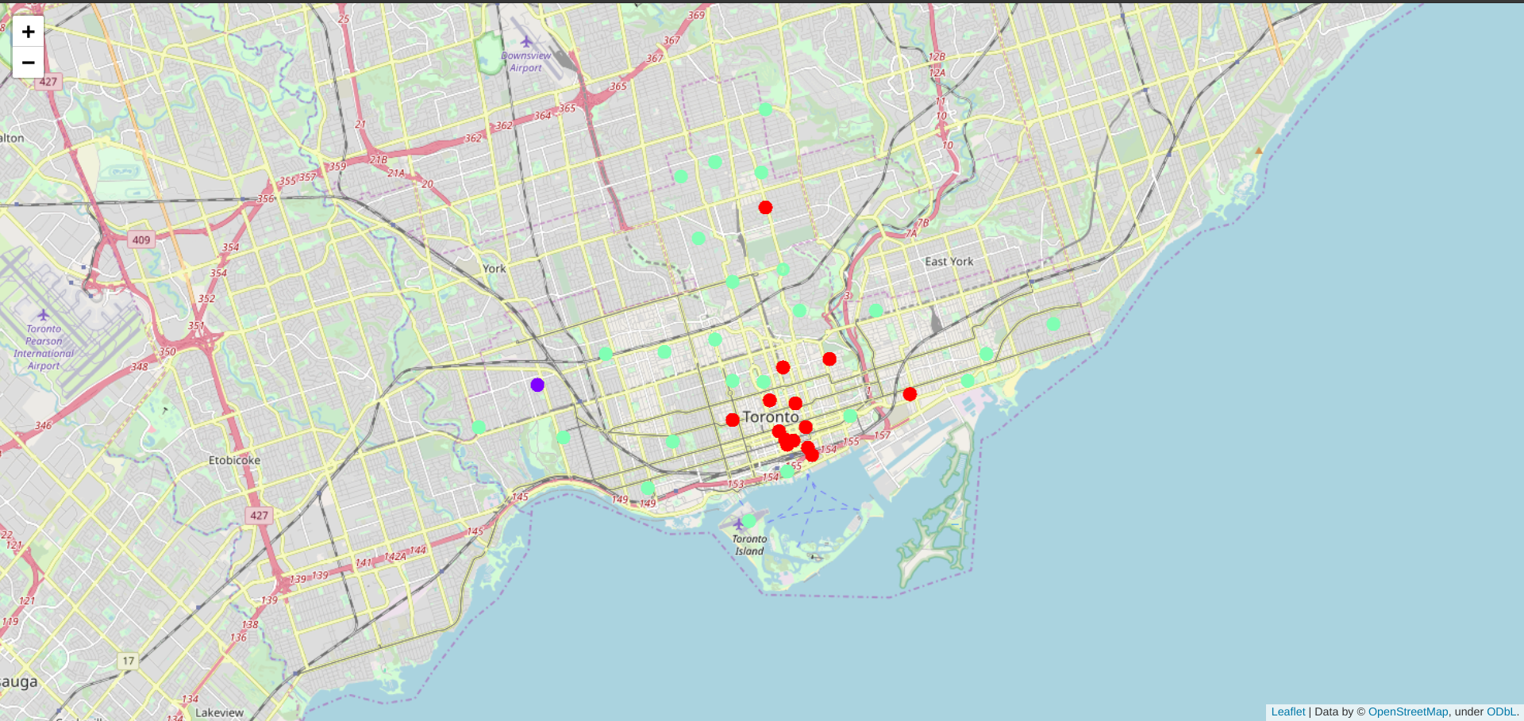
Clustered the neighborhoods in Toronto into 3 clusters based on their frequency of occurrence for “Thai food”.
Cluster 0 (Red): Neighborhoods with little or no Thai restaurants
Cluster 1(Purple): Neighborhoods with no Thai restaurants
Cluster 2(LGreen): Neighborhoods with high number of Thai restaurants

Slide 7
Most of Thai restaurants are in Cluster 2 which is around Adelaide, King, Richmond areas and lowest (close to zero) in Cluster 1 areas which are North Toronto West and Parkdale
areas.
Also, there are good opportunities to open near Chinatown, St James town as the competition seems to be low. Looking at nearby venues, it seems Cluster 1 might be a good location as there are not a lot of Asian restaurants in these areas. Therefore, this project recommends the entrepreneur to open an authentic Burmese restaurant in these locations with little to no
competition. Nonetheless, if the food is authentic

Slide 8
Conclusion :
In this project, we have gone through the process of identifying the business problem, specifying the data required, extracting and preparing the data, performing the machine
learning by utilizing k-means clustering and providing recommendation to the stakeholder.

